Slide 1

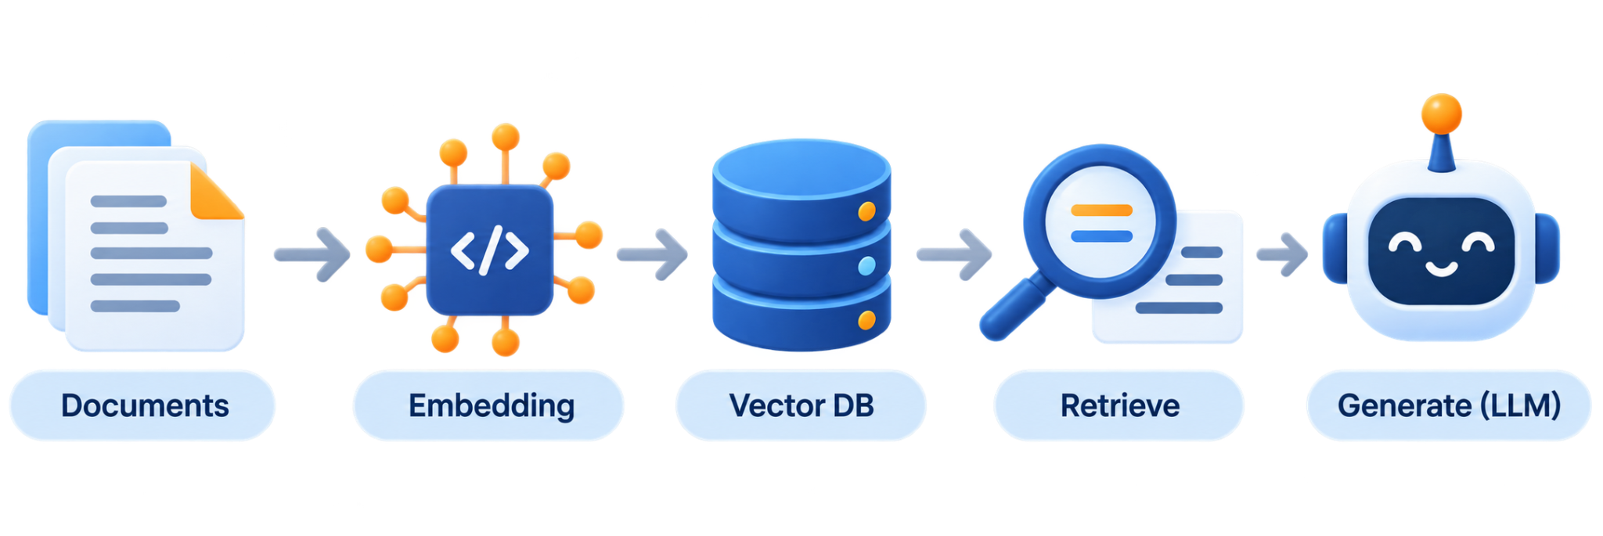
RAG Fundamentals
Prepared by Instructor Team

Slide 2






WHAT WE'LL COVER
Table of Contents
01
02
03
RAG Architecture Overview
The RAG Pipeline
Local Embedding Models
What RAG is, why it exists, and how it evolves from naive to agentic.
Ingestion, chunking, embedding, retrieval, and generation — five stages, step by step.
Choosing a model that turns text into meaning, and runs on your own hardware.
04
05
06
Vector Database Setup
Building the RAG App
Code Walkthrough
Where millions of embeddings live, and how fast they can be searched.
A working terminal chatbot, built by hand with no framework hiding the pipeline.
Reading the four files that turn the pipeline into working code.

Slide 3

01
RAG Architecture Overview
What RAG is, why we use it, and how it develops from basic RAG to agentic RAG.

Slide 4








Definition
What Is RAG?
Retrieval-Augmented Generation is an architecture that connects a language model to an external knowledge base, so it can retrieve relevant information before answering - rather relying solely on its trained data
PLAIN LLM — answers from memory
RAG — answers from lookup
User Question
→
Retriever
searches knowledge base
LLM
Question
+ retrieved text
User Question
→
→
→
Answer
LLM
(training data only)
→
Answer
Can search the web, but cannot access private or internal information that isn’t publicly available or connected.
Looks things up in real documents first, then answers from what it found — not just what it has learned.

Slide 5
Motivation
Why RAG Exists
A plain LLM has real weaknesses — RAG addresses each one directly:
1
Hallucination
2
Staleness
The model confidently states things that are false. RAG grounds its answers in retrieved, real text.
Model knowledge stops at its training cutoff. RAG lets it pull in documents created after that date.
3
No source of truth
4
Expensive to update
A plain model can't show where its answer came from. RAG can point back to retrieved passages.
Fine-tuning for new information is costly and slow. RAG updates behavior just by updating the stored documents.

Slide 6
Structure
The Two Pipelines of RAG
RAG isn't one process. It's two separate pipelines that run at different times.
OFFLINE / SETUP PIPELINE
(runs once, or whenever documents change)
ONLINE / QUERY-TIME PIPELINE
(runs on every question)
1
→
2
→
3
→
4
1
→
2
→
3
→
4
→
5
Ingest
Chunk
Embed
Store in Vector DB
Query
Embed Query
Retrieve
Augment
Generate
Key Distinction: only the incoming query gets embedded live. Documents are already embedded and waiting in the vector database.
Why it matters: understanding this split prevents the most common mix-up - thinking the whole document library gets re-processed every time someone asks a question.

Slide 7
Process
The Five-Stage Pipeline
Once a user asks a question, RAG moves through five stages to produce an answer.
1
2
3
4
5
→
→
→
→
Query
Embed
Retrieval
Augment
Generate
Query & Retrieval
Integration & Augmentation
Generation
The user's question is asked, then used to search the vector database for the most relevant chunks of text.
The retrieved chunks are combined with the original question to build one enriched prompt (question + context + instructions).
The LLM reads the augmented prompt and produces the final, grounded answer.
Why it matters: each stage adds a checkpoint where the answer gets grounded in real retrieved text rather than just guessing from memory.

Slide 8
Vocabulary
Core Components
A few key terms show up throughout every RAG system - worth knowing before we build one.
Knowledge Base
Chunk
Embedding
The external documents a system can draw on.
A document broken into segments sized to fit retrieval and the model's context window.
A vector representation of a chunk or query's meaning.
Vector Database
Retriever
Generator
A specialized database optimized for fast similarity search.
The component that finds the most relevant chunks for a query.
The LLM that turns those chunks into a final answer.
Why it matters: these six terms are the vocabulary for every remaining topic
- chunking, embeddings, and vector databases each get their own dedicated lesson later.

Slide 9
How RAG Evolves
Naive RAG
The simplest working version of the pipeline: three components (vector database, embedding model, LLM) working through four steps (index, retrieve, augment, generate).
Vector Database
Embedding Model
LLM
Holds the document embeddings
Turns each question into a vector
Generates the answer from whatever gets retrieved
WHERE IT'S USED
WHAT DETERMINES QUALITY
Customer support portals answering from help articles, internal knowledge bases for policy lookup, and product documentation search - cases where "close enough" retrieval is good enough.
Chunk size (roughly 500–1000 tokens is the common starting range), which vector database you pick, and how fast it can search.

Slide 10
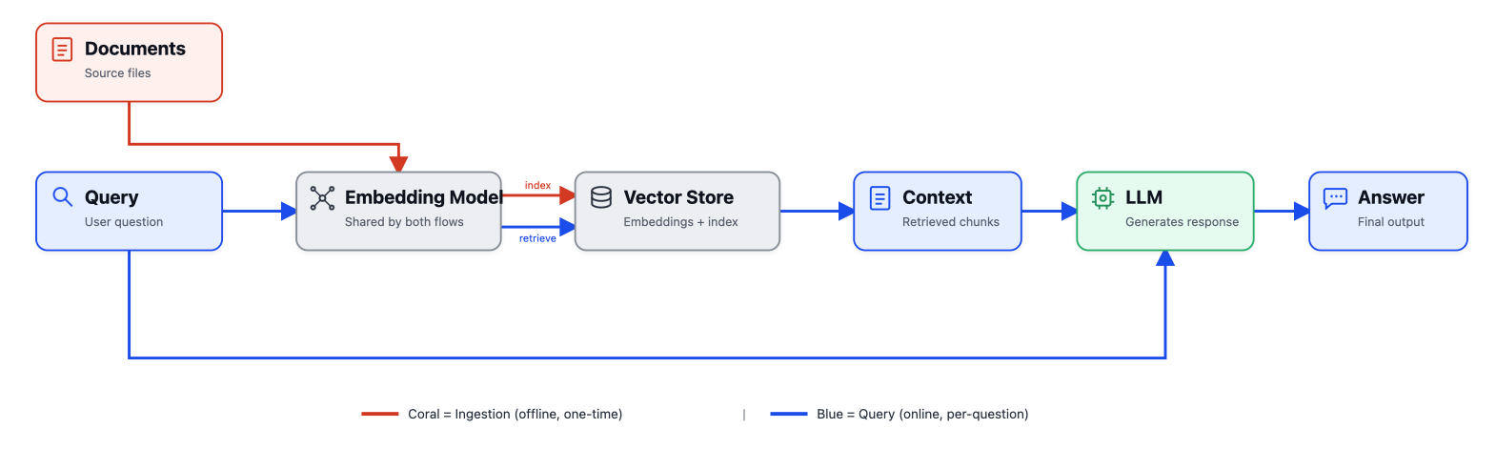
How RAG Evolves
Naive RAG
Why it matters: This is the version of RAG our baseline app builds today
and it’s also the version already running in productions support tools and internal wikis at real companies.

Slide 11


How RAG Evolves
Advanced RAG
Keeps the same 3 components as Naive RAG. It doesn't add new parts, it adds checkpoints around the same search steps, so a bad match gets caught instead of going straight to the LLM.
Smarter search, not just similarity
A ranking pass after retrieval
Combines semantic vector search with traditional keyword search (hybrid search), and rewrites the question into several alternate phrasings before answering - so a poorly worded query doesn't sink the whole answer.
Rather than trusting the raw similarity score, a second stage reranks and filters what came back, and the context handed to the LLM adjusts based on what the question actually needs.
WHERE IT EARNS ITS KEEP
Legal teams researching case law where precision matters, healthcare researchers doing literature review and clinical support, and financial firms handling market research and compliance documents - fields where a wrong "close enough" answer is expensive.

Slide 12
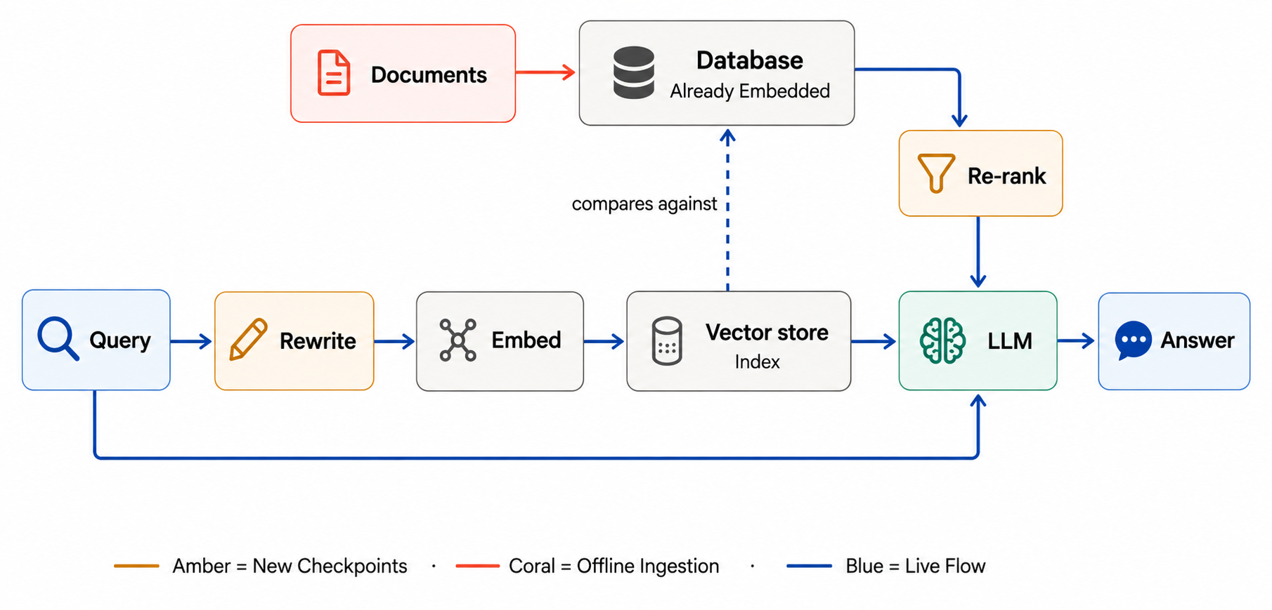
How RAG Evolves
Advanced RAG
Why it matters: every added step here answers the same question: "Is this actually the most useful context, or just the most similar text?”. That's the exact gap Naive RAG's weak point flagged.

Slide 13
How RAG Evolves
Agentic RAG
What if one search-and-rerank pass still isn't enough? Instead of one retrieval step,
the system plans, delegates, and reasons in stages.
Planning and specialized agents
Memory and visible reasoning
A task-planning module breaks a complex query into subtasks, then hands them to multiple specialized agents — different agents handle different parts of the job, rather than one component doing everything.
A memory system maintains context across reasoning steps, while a chain-of-thought framework keeps the reasoning path explicit — so you see how the system got to its answer, not just what it answered.
WHERE IT EARNS ITS KEEP
Strategy consulting firms use it for market analysis and strategic planning, academic institutions apply it to literature review and hypothesis generation, and tech companies use it for automated code generation and documentation.

Slide 14
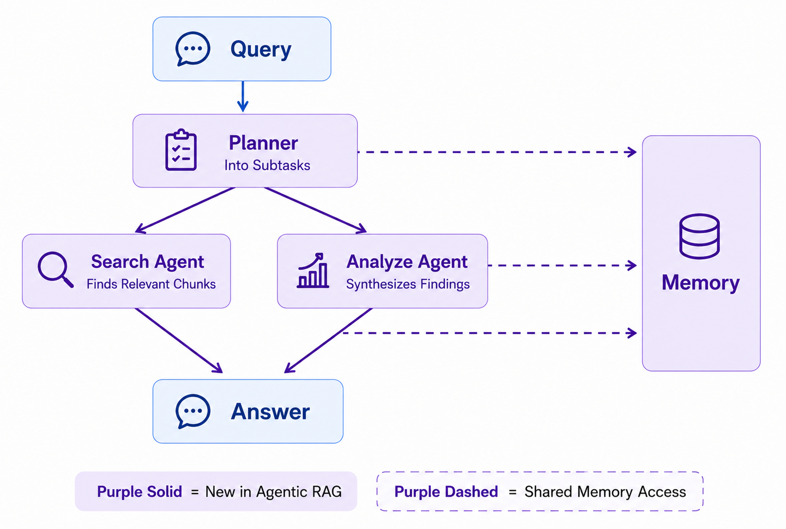
How RAG Evolves
Agentic RAG
Why it matters: This is the shape real reasoning systems take in productions – several focused steps working together, with a visible trail of how they got there. It’s also the natural next step after Workflow Engineering: this is the multi-step chaining and state management, just applied specifically to retrieval.

Slide 15

02
The RAG Pipeline
Ingestion, chunking, embedding, retrieval, and generation
— five stages, step by step.

Slide 16
Stage 1
Ingestion — Getting Data In
Before anything can be retrieved, raw documents have to be pulled into the pipeline — the first stage, and the easiest to overlook.
WHAT IT IS
WHY IT'S TRICKY
COMMON FAILURE MODES
Connecting to data sources (PDFs, web pages, docs, databases) and pulling their content into the pipeline.
Most attention goes to retrieval and generation, but ingestion is the stage that breaks first — and most quietly.
Retrieving both an old and new version of the same document, or rebuilding the entire store instead of processing only what changed.
Why it matters: a RAG system is only as good as the data it can see — if ingestion misses updates or duplicate content, no amount of clever retrieval or generation can fix a broken foundation.

Slide 17
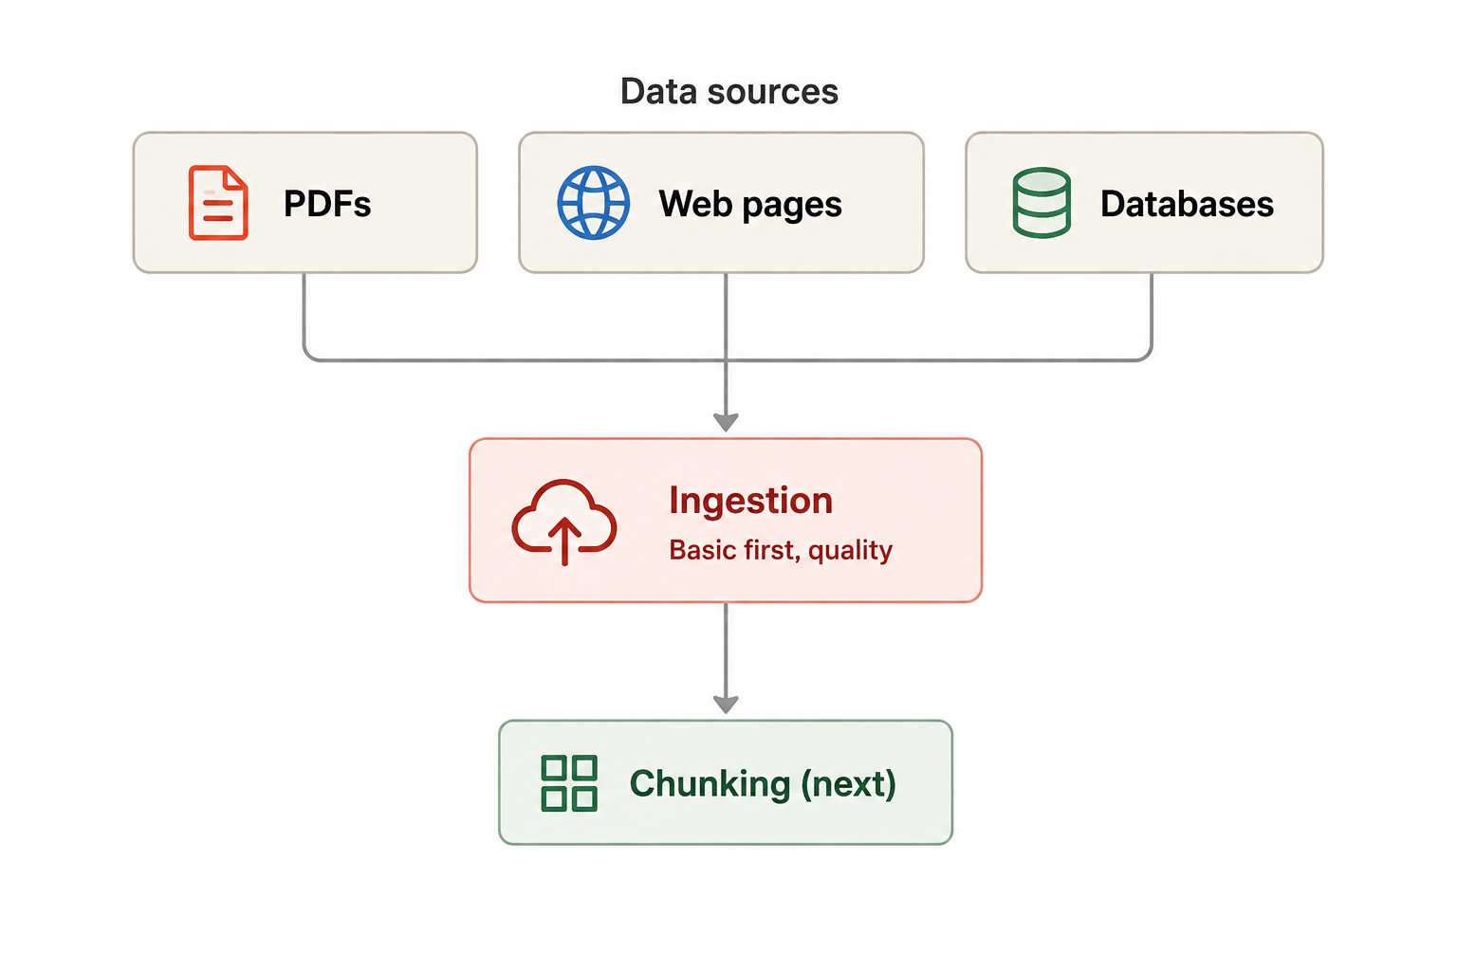
Stage 1
Ingestion — Illustration
Notes: When ingesting make sure the content are clean and well structure because quality in this stage matters a lot – “garbage in, garbage out”

Slide 18
Stage 1
Ingestion - Loading Demonstration
Loops into the path if the documentation directory and look for any file that has extension ‘.txt’
Then append the file name and content into document list and return the document
fo
ingestion.py
def load_documents(docs_dir:str) -> list[dict]:
#reads every .txt / .md -> returns {source, text}
documents = []
for filepath in Path(docs_dir).glob("*.txt"):
documents.append({"source": filepath.name,
"text": filepath.read_text()})
return documents

Slide 19
Stage 1
Ingestion - Loading Demonstration
Code Explanation
When Takes in the docs_dir as string type and return a list of [dict]
document = [] – initially start out as an empty array
filepath.name and not a full path: this is our stable document-id.
If we ingest the same document file twice, we would want it to recognize to be the same file and not silently create duplicate files.

Slide 20
Stage 2
Chunking - Splitting Documents Into Pieces
It is the process of dividing large pieces of information, such as documents, transcripts, or technical manuals, into smaller, more manageable segments. These segments can then be processed, embedded, and retrieved by AI systems.
Why does chunking matter in the architecture?
AI model can only read a limited amount of text at once – chunking break a huge document into pieces that actually fit
Notes: So chunking is necessary – but where exactly do we cut? There is more than one answer to that question.

Slide 21
Stage 2 — Chunking
Fixed-Size Chunking
Cuts the text at a fixed length - for example, if the fixed length is 40 characters -
no matters where the sentence or ideas begin it will still cut and that fixed length.
CHARACTERISTICS
✓ Very fast — no extra processing needed
✕ Can cut a sentence right in the middle, losing its meaning
Best for: quick prototypes, or text that's already short and uniform.
The simplest chunking method to build, but the risk of breaking a sentence mid-way makes it a weak default for real documents.

Slide 22
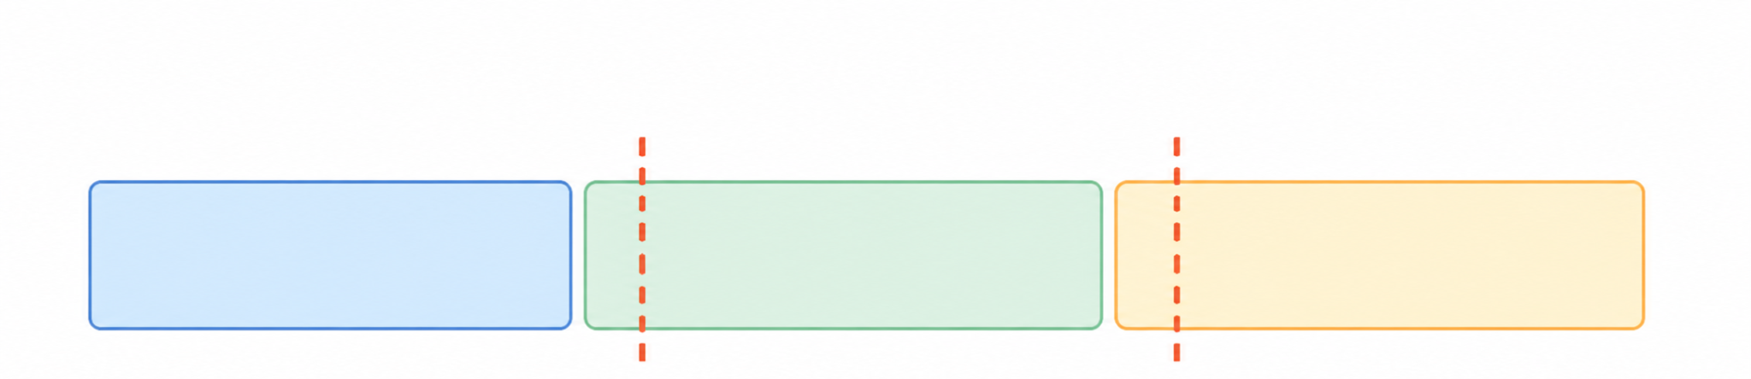
Stage 2 — Chunking
Fixed-Size Chunking
This is the most simplest form of chunking method to build, but the risk of breaking sentence mid-way make it a weak default options for real document chunking
Chunk 1
Chunk 2
Chunk 3
Cuts fall anywhere - may slice mid-sentence

Slide 23
Stage 2 — Chunking
Fixed-Size Chunking Demonstration
fixed_size.py
Result
def fixed_size_chunk(text, source, size=40):
chunks = []
for i in range(0, len(text), size):
piece = text[i : i + size]
chunk_id = f”{source}::chunk_{len(chunks)}”
chunks.append(Chunk(chunk_id=chunk_id, text=piece))
return chunks
[pets_example.txt::chunk_0] “Dogs are loyal animals that have lived w”
[pets_example.txt::chunk_1] “ith humans for thousands of years. They ”
[pets_example.txt::chunk_2] “can be trained to do helpful tasks, like”
Try it yourself: change size=40 to something bigger or smaller and re-run — watch where the cuts land differently

Slide 24
Stage 2 — Chunking
Recursive Chunking
Tries to cut at the most natural break first - paragraph then sentence - and only move to a smaller break if the chunk is still too big. It also does chunk overlap so it does not cut in the middle of a sentence
CHARACTERISTICS
✓ Keeps every sentence whole - cuts happen only at sentence gaps
✓ Falls back to a smaller break only when needed to fit the size limit
Best for: most real documents - this is the usual default choice.
Why it matters: Most RAG applications start here. It respects sentence boundaries instead of cutting blindly, without the extra cost of semantic chunking.

Slide 25
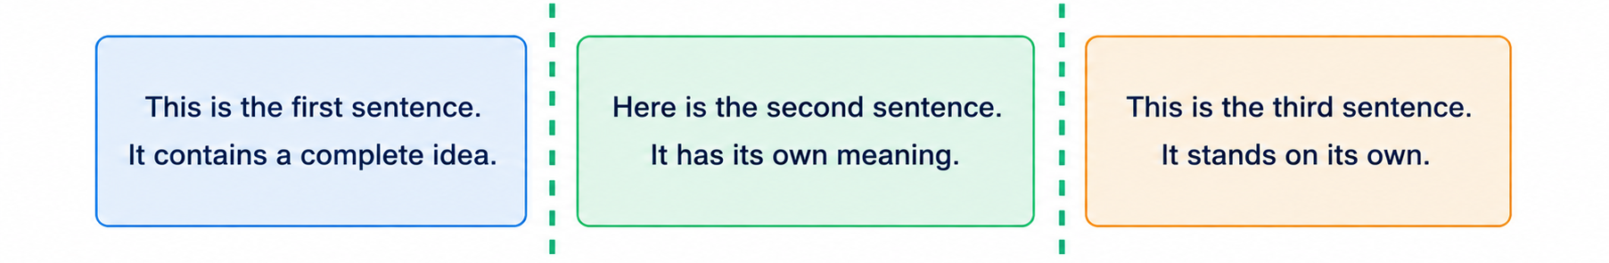
Stage 2 — Chunking
Recursive Chunking - Example
Cuts fall between sentences - preserves each sentence
Example — limit ~2 sentences per chunk
[chunk_0] "Dogs are loyal... guiding blind people."
[chunk_1] "Cats are more independent... low-maintenance pets."
(Here it happened to land on the topics shift from sentence 1 to sentence – but for future reference recursive chunking isn’t aware of this)

Slide 26
Stage 2 — Chunking
Recursive Chunking Demonstration
fixed_size.py
Result
SEPARATORS = ["\n\n", ". ", " "] # paragraph → sentence → word
def recursive_chunk(text, source, size=150):
pieces = _recursive_split(text, size, SEPARATORS)
return [Chunk(chunk_id=f”{source}::chunk_{i}”, text=p.strip())
for i, p in enumerate(pieces) if p.strip()]
[pets_example.txt::chunk_0] “Dogs are loyal animals… guiding blind people.”
[pets_example.txt::chunk_1] “Cats are more independent… low maintenance pets.”
Try it yourself: change size=150 to something bigger or smaller - see when sentences start splitting apart or merging further.

Slide 27
Stage 2 — Chunking
Semantic Chunking
Groups sentences by meaning - nearby sentences with the same meaning stay together, and a new chunk starts only when the topic has shifted.
CHARACTERISTICS
✓ Most accurate at keeping full ideas together
✕ Needs extra processing to compare meaning between sentences - slower and costlier
Best for: long documents that mix several topics (reports, manuals...).
Why it matters: it produces the most natural chunks, but that quality comes at a real compute cost - worth knowing before defaulting to it.

Slide 28
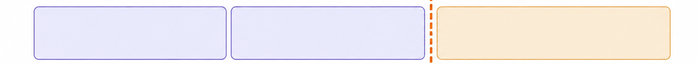
Stage 2 — Chunking
Semantic Chunking
Same Topic
New Topic
Cuts fall only where meaning shifts - groups related sentences
Example — split follows topic, not length
Chunk 1 — topic: dogs
Chunk 2 — topic: cats
"Dogs are loyal animals... guiding blind people."
"Cats are more independent... low-maintenance pets."
This time the split happens because the topic changed - not because of length or position.

Slide 29
Comparison
Chunking Strategies Compared
Strategy
How it decides where to cut
Speed & Cost
Best for
Fixed-size
Fixed length (characters/tokens), ignores content
Fastest - no extra processing
Quick prototypes, short uniform text
Recursive
Natural breaks first (paragraph → sentence → word), as fallback
Fast - no embedding calls needed
Most real documents -the default choice
Semantic
Where the topic/meaning actually shifts
Slowest - needs embedding comparisons
Long documents mixing several topics

Slide 30

Stage 3
Embeddings - Turning Text into Meaning
Once text is chunked, each chunk gets converted into a list of numbers - an embedding - that captures what it means, not just what words it contains.
WHAT IT IS
A vector positioned in a high-dimensional space, where chunks with similar meaning end up close together, and unrelated chunks end up far apart.
Chunk
Vector
"Dogs are loyal..."
[0.21, -0.32, 0.68, ...]
[0.19, -0.28, 0.71, ...]
[-0.94, 0.55, -0.12, ...]
Embedding
Model
"Cats are..."
"Stocks rose..."

Slide 31
Stage 3
Embeddings - Turning Text into Meaning
Semantic search, not keyword search
A query about "puppy" can still retrieve a chunk about "dog" - the embedding captures meaning, not exact word matches.
Two embedding calls happen in RAG
Documents get embedded once during ingestion (offline); the user's query gets embedded again at question time (online) - using the same embedding model for both, so they land in the same space.
Why it matters: embeddings are what make "search by meaning" possible at all - without them, retrieval would only ever find exact keyword matches, missing anything phrased differently.

Slide 32
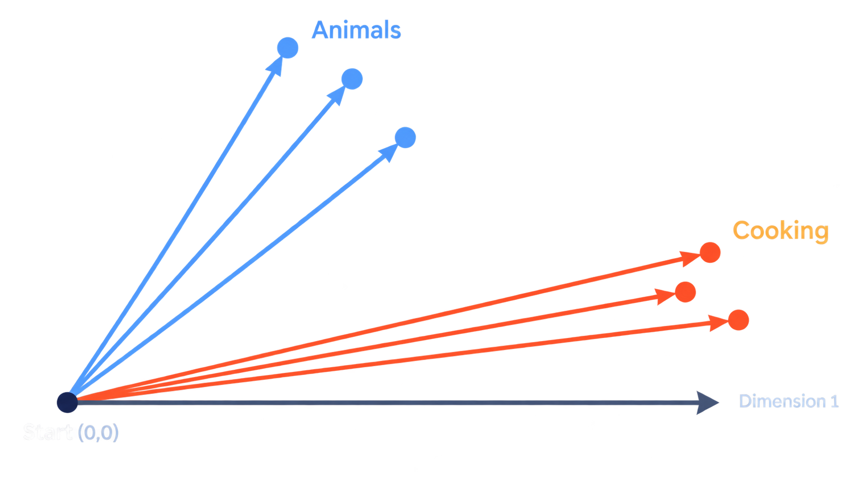
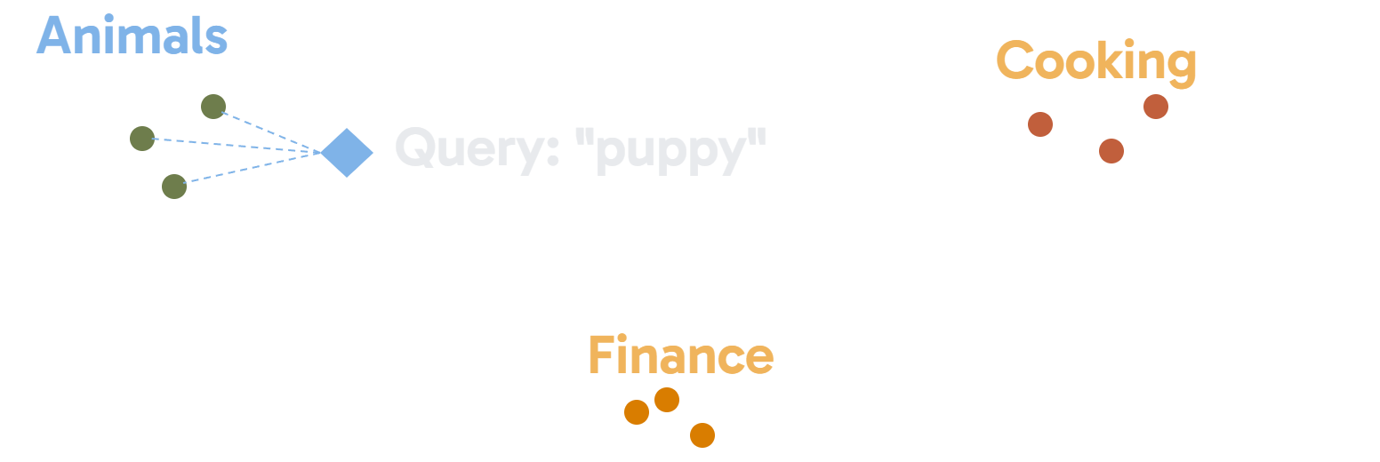
Stage 3
Embeddings - Illustration
Vector Positioning in Space
User’s Query
Vectors pointing the same way share a similar meaning (Showing in 2D - real embeddings use hundred of dimensions.)
Query: "puppy" lands close to Animals, even without the word "dog"

Slide 33

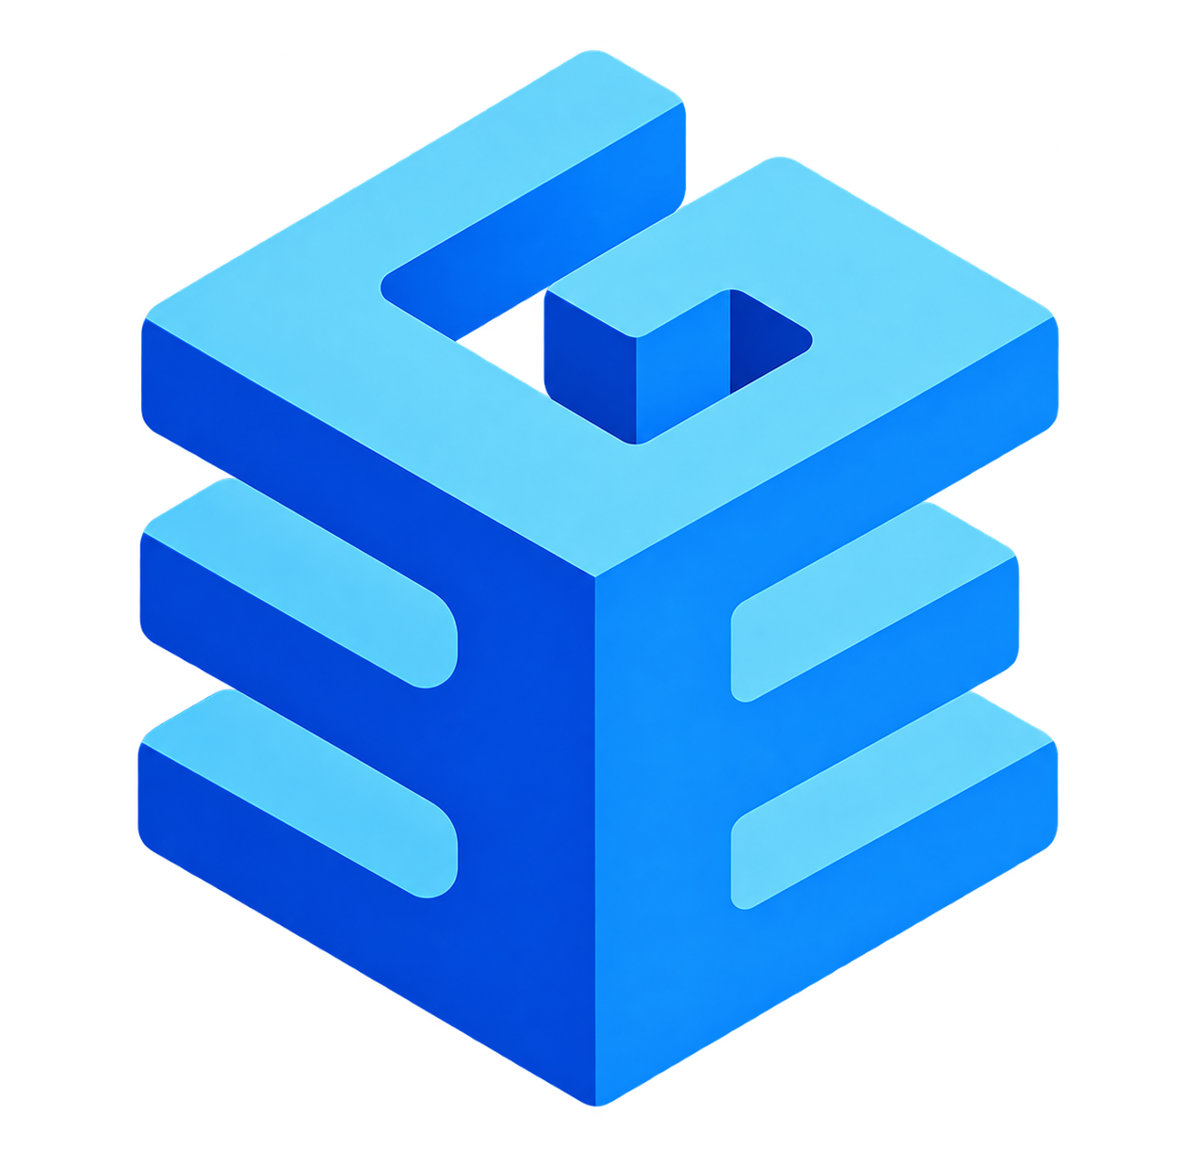
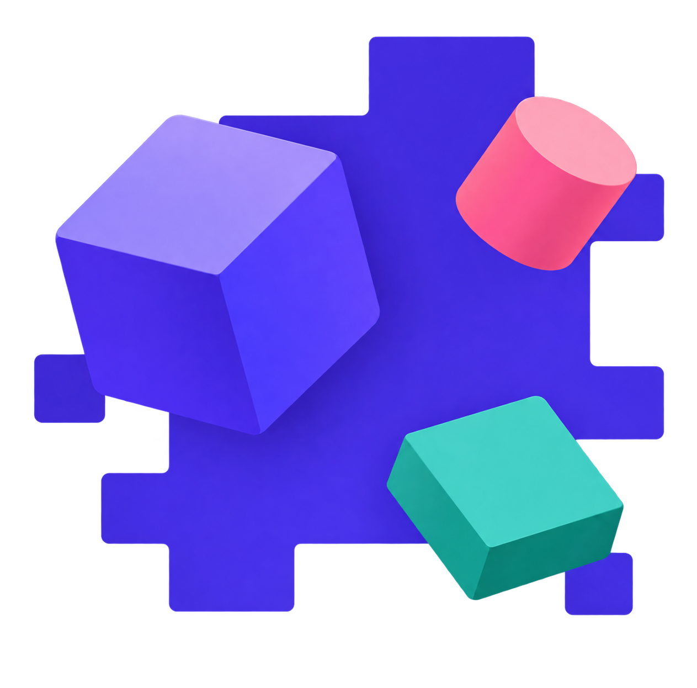
Stage 3 - Embedding
Choosing an Embedding Model
Just like there's more than one LLM, there's more than one embedding model and the choice affects both speed and retrieval quality.
Nomic-embed-text
BGE-M3
all-MiniLM-L6-v2
The model this course uses (via Ollama). The most-pulled embedding model on Ollama, lightweight enough to run on a laptop.
A heavier, multilingual option. MIT-licensed, supports 100+ languages, and offers dense, sparse, and multi-vector retrieval in a single model.
The smallest, fastest option, and the default starting point in the sentence-transformers library - though it trades away some accuracy for speed.
Note: the model you pick trades off speed, accuracy, and language support - full specs in the Local Embedding Models section ahead.

Slide 34
Stage 4
Retrieval — Finding the Right Chunks
Once the query is embedded, the system searches the vector database for the chunks whose embeddings sit closest to it. This is where "search by meaning" actually happens.
Similarity search
The distance-naming note
Top-k retrieval
The query's vector is compared against every stored chunk vector, most commonly with cosine similarity - how closely two vectors point in the same direction, regardless of length.
ChromaDB (and most vector databases) report this as a distance , not a similarity score - smaller distance means a closer match, the opposite direction from similarity.
Once every chunk is scored, retrieval returns a fixed number of the top-scoring ones - never "the one best chunk" or "every chunk."
Why it matters: retrieval quality is the ceiling on the whole system - even a perfect LLM can't generate a good answer if it never receives the right context to begin with.

Slide 35
Stage 4
Three Ways to Search
Vector similarity isn't the only way to find relevant chunks - systems typically choose from three strategies.
Method
How it matches
Best for
Weakness
Keyword
Exact word overlap
Exact terms, codes, names
Misses synonyms / paraphrase
Vector
Semantic similarity
Meaning-based queries
Can miss exact terms
Hybrid
Both, merged
Most production systems
More setup, slower
Keyword search: simple and fast, but struggles with synonyms (a query about "puppy" won't match a chunk that only says "dog"). Vector search: the method our baseline app uses - strong semantic relationships but can miss exact terms like product codes.
Naive RAG (what we're building) uses vector search alone - hybrid search is the first upgrade most production teams reach for when vector search starts missing matches.

Slide 36
Stage 5
Generation - Building the Final Prompt
With the top-k chunks in hand, the system builds one prompt and hands it to the LLM.
Three parts go in; a grounded answer comes out.
THE AUGMENTED PROMPT
Instruction
"Answer using only the context below. If it isn't there, say “you don't have enough information.”"
LLM
reads the whole prompt
Context
↓
The retrieved chunks, joined into one block of text.
Question
Grounded answer
The user's original question, word for word.
built from the context, not from memory
Note: this single string is everything the model sees. If a fact is not in the context, the model has no way to know it.

Slide 37
Stage 5
Generation - Grounded Answer
Instruction sent with every prompt: "Answer using only the context below. If the answer isn't in the context, say 'I don't have enough information to answer that.'"
Case 1 — good retrieval
Case 2 — weak or empty retrieval
query
query
"What are dogs known for?"
"What is the capital of Mars?"
↓
↓
chunk retrieved
no relevant chunks
"Dogs are loyal animals that have lived with humans…"
nothing in the vector database matches
↓
↓
grounded answer
honest non-answer
"Dogs are known for loyalty and companionship…"
"I don't have enough information to answer that."
No match, no guess: Case 2 is the system working correctly — saying so beats inventing an answer from memory.

Slide 38
Stage 5
Generation - Grounded Answer
Two things separate a RAG answer from a plain chatbot answer.
Grounded, not from fact it trained on
Streaming output
The answer is built from the retrieved text sitting right in front of the model — not from facts it memorized during training. That is what makes RAG answers more accurate and easier to keep up to date: you update the documents, not the model.
Most RAG interfaces — including our baseline CLI — print the answer token by token as it is generated, instead of waiting for the whole response. The wait feels shorter and you can stop a bad answer early.
Why it matters: this is the payoff of every earlier stage — ingestion, chunking, embedding, and retrieval all exist to get the right text in front of the LLM at exactly this moment.

Slide 39
Stage 5
Code Demo - generation.py
generation.py — the instruction and the builder
try it — a chunk was retrieved
INSTRUCTION = (
"Answer using only the context below. "
"If the answer isn't in the context, say "
"'I don't have enough information.'"
)
def build_prompt(query: str, chunks: list[str]) -> str:
if not chunks:
context ="(no relevant chunks found)"
else:
context ="\n".join(f"- {c}" forcinchunks)
return(
f"{INSTRUCTION}\n\n"
f"Context:\n{context}\n\n"
f"Question: {query}"
)
prompt1 = build_prompt(
"What are dogs known for?",
["Dogs are loyal animals…"]
)
print(prompt1)
try it — nothing retrieved
prompt2 = build_prompt(
"What is the capital of Mars?",
[]
)
print(prompt2)

Slide 40

03
Local Embedding Models
Choosing a model that turns text into meaning, and runs on your own hardware.

Slide 41

Selection
Choosing a Model to Run Locally
Several open-source embedding models can run locally through tools like Ollama - no API key, no per-query cost, and your documents never leave your machine.
Lightweight & fast
Balanced, general-purpose
Specialized (multilingual)
Smaller models run on ordinary hardware with no GPU required, ideal for prototyping — the tradeoff is somewhat lower retrieval accuracy.
Mid-size models offer noticeably better retrieval quality for a modest increase in memory use and speed — a good default for most projects.
Some models are purpose-built for multilingual or mixed-language retrieval — matters if your documents span more than one language.
Object 1
  Keynote:
  there is no single "best" embedding model — only the best one for your documents, your language mix, and your hardware. Test a couple of options against your own content.
[0.21, -0.32, ...]
[0.79, -0.14, ...]
[-0.94, -0.42, ...]
Object 2
Embedding Model
Object 3

Slide 42
Comparison
Embedding Model Comparison
Model
Dimension
Max Sequence Length
Parameters
License
Language Support
nomic-embed-text
768
8192 (2048 by default via Ollama)
137M
Apache 2.0
English
BGE-M3
1024
8192
568M
MIT
100+ languages
all-MiniLM-L6-v2
384
256word pieces (default truncation)
~22M
Apache 2.0
English (primarily)

Slide 43
Local Models
Code Demo — Embedding Text Locally
In this demo, we use Ollama and the nomic-embed-text model to convert a sentence into a numerical vector. This is the same embedding process used later in RAG for storing and searching text by meaning. Three steps: Pull the embedding model, write a simple Python script, and convert text into a numerical vector locally.
Terminal
$ollama pull nomic-embed-text:latest
pulling manifest → 970aa74c0a90 (274 MB)
verifying digest → success
$nano embed.py
Keynote: Use the same embedding model for both your documents and user queries. If you embed your documents with nomic-embed-text, you should also use nomic-embed-text to embed the user's query so both vectors can be compared correctly. Using a different model can produce incompatible vectors, so similarity search may not work correctly.
Notes:
Real terminal output from running this ourselves: pull the model once (274 MB, then cached), write embed.py in nano (shown on the left, exact file), then run it — python3 embed.py prints the vector's dimension and first five values. Emphasize that individual numbers are meaningless — only relative distance between vectors encodes meaning.

Slide 44
Local Models
Code Demo — Embedding Text Locally
Write the simple python script: embed.py
GNU nano 7.2 embed.py
import ollama
# Text that we want to convert into an embedding vector
text = "An embedding model converts text into numerical vectors that capture semantic meaning."
# Generate the embedding
response = ollama.embed(
model="nomic-embed-text:latest",
input=text
)
# Extract the vector
vector = response["embeddings"][0]
# Show the vector dimension
print("Vector dimension:", len(vector))
# Show the first 5 values
print("First 5 values:", vector[:5])
Notes:
Real terminal output from running this ourselves: pull the model once (274 MB, then cached), write embed.py in nano (shown on the left, exact file), then run it — python3 embed.py prints the vector's dimension and first five values. Emphasize that individual numbers are meaningless — only relative distance between vectors encodes meaning.

Slide 45
Local Models
Code Demo — Embedding Text Locally
Runs the Python script.
Terminal
$python embed.py
Vector dimension: 768
First 5 values: [-0.008506611, 0.035194483, -0.15673032, -0.09258528, 0.068800375]
Vector dimension: 768
The embedding model converted the input text into a vector containing 768 numerical values.
First 5 values: [...]
These are the first 5 numbers from the 768-dimensional vector.
Each number is one coordinate representing part of the text's semantic information.
Notes:
Real terminal output from running this ourselves: pull the model once (274 MB, then cached), write embed.py in nano (shown on the left, exact file), then run it — python3 embed.py prints the vector's dimension and first five values. Emphasize that individual numbers are meaningless — only relative distance between vectors encodes meaning.

Slide 46

04
Vector Database Setup
Where millions of embeddings live, and how fast they can be searched.

Slide 47
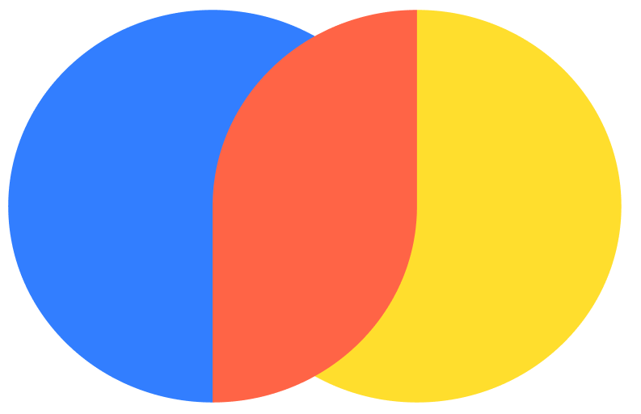


Setup
Choosing Where to Store Your Vectors
A vector database stores millions of embeddings and makes similarity search fast - here are the three most common choices for a local RAG project.
ChromaDB
Qdrant
Pgvector
No server, no Docker, no schema setup — runs in-process for the fastest path to a working demo. Best for prototypes and small projects (up to ~1 million vectors).
Built for speed and precise filtering at larger scale, but requires running a separate server — the right choice once a project outgrows prototype size.
Adds vector search directly into an existing PostgreSQL database — no new infrastructure needed. Best when a project already runs on Postgres.
Why it matters: the right database depends on scale and existing infrastructure, not raw performance alone - our baseline app uses ChromaDB because it lets us focus on learning the pipeline, not managing a database server.

Slide 48
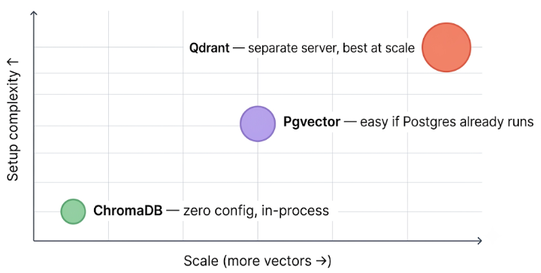
Setup
Choosing Where to Store Your Vectors
Up and to the right costs more to run. Start bottom-left and only move when scale forces you to.

Slide 49
Setup
ChromaDB Setup
ChromaDB can run locally on your own computer. Get these 3 things ready and run the commands.
1 · Python
2 · A project folder
3 · A virtual environment
Python already installed. Type python --version in a terminal to check.
An empty folder to work in, so all your files stay in one place.
A private Python space for this project, so installing Chroma cannot affect your other projects.
Terminal
$mkdir chroma-demo && cd chroma-demo # create the folder and enter it
$python -m venv .venv # create the virtual environment
$source .venv/bin/activate # Activate it · Windows: .venv\Scripts\activate
$pip install chromadb # install ChromaDB
$pip show chromadb # displays information about the installed ChromaDB package

Slide 50
Setup
Quick Start - Create & Add document
quickstart.py
import chromadb
# 1. Create the ChromaDB client
client = chromadb.Client()
# 2. Create the collection
collection = client.get_or_create_collection(name="my_collection")
# 3. Add documents
collection.upsert(
ids=["id1","id2"],
documents=[
"This is a document about pineapple",
"This is a document about oranges"
]
)

Slide 51
Setup
Quick Start - Search, Print & Delete
quickstart.py
# 4. Search
results = collection.query(
query_texts=["fruit from tropical places"], n_results=2
)
# 5. Print Result
print("Query Results:")
for i in range(len(results["ids"][0])):
print(f"\nResult {i + 1}")
print("ID:", results["ids"][0][i])
print("Document:", results["documents"][0][i])
print("Distance:", results["distances"][0][i])
# 6. Delete collection
client.delete_collection(name="my_collection")

Slide 52
Setup
Quick Start - Search, Print & Delete
quickstart.py
Query Results:
Result 1
ID: id1
Document: This is a document about pineapple
Distance: 1.066545844078064
Result 2
ID: id2
Document: This is a document about oranges
Distance: 1.1986472606658936
( Your distances number will differ )
What the numbers mean
A smaller distance means a closer meaning. Pineapple wins even though neither document says "tropical".

Slide 53

05
Building the RAG App
A working terminal chatbot, built by hand with no framework hiding the pipeline.

Slide 54
Overview
What You're Building
The baseline app puts every concept from this deck into a working terminal chatbot -
built from scratch, with no RAG framework hiding the pipeline from you.
No framework, no magic
Two commands, two pipelines
Every stage - ingestion, chunking, embedding - is written by hand so you see exactly what each step does and why it exists.
python main.py ingest runs the offline pipeline once to load, chunk, embed, and store documents; python main.py chat starts the loop that answers every question you type.
STACK
Python + Poetry + Ollama (llama3.2 for generation, nomic-embed-text for embedding) + ChromaDB as the persistent vector store
Why it matters: every file in this project maps to exactly one stage of the pipeline — there is no layer you cannot open and read.

Slide 55
Structure
Project Structure — One File, One Concept
The /src layout keeps each pipeline stage isolated - changing how chunking works never touches retrieval, and swapping the vector store never touches generation.
src/ingestion.py
Offline pipeline: load documents, chunk text, embed, store in ChromaDB.
src/retriever.py
Online pipeline step 1: embed the query, collection.query returns top-k chunks with distance scores.
src/generator.py
Online pipeline step 2: build_prompt assembles question + context + instructions, generate streams the answer token by token.
pipeline.py + main.py
The glue: pipeline.py wires retriever and generator together; main.py exposes ingest and chat modes via CLI.
Why it matters: if something goes wrong - wrong chunks retrieved, bad answer generated - this structure tells us exactly which file to check first.

Slide 56

06
Code Walkthrough
Reading the four files that turn the pipeline into working code.

Slide 57
Code Example — File 1
ingest.py
The offline pipeline - runs once, loads everything into ChromaDB.
# Four functions, four stages
def load_documents(docs_dir) -> list[dict]:
# reads every .txt / .md → returns {source, text}
def chunk_text(text, chunk_size=500, overlap=50) -> list[str]:
# slides a window across text, snaps cuts to "."
def embed(text) -> list[float]:
# ollama.embed(model="nomic-embed-text", input=text)
def ingest(docs_dir) -> None:
# orchestrates: load → chunk → embed → collection.add()
chunk_id = f"{source}::chunk_{i}" ← prevents duplicates

Slide 58
Code Example — File 2
retriever.py
The first step of the online pipeline - turns a question into a vector, finds the closest chunks.
# Three functions
def get_collection() -> Collection:
# PersistentClient(path=".chroma").get_collection("rag_docs")
# get_collection ← NOT get_or_create (must ingest first)
def embed_query(query) -> list[float]:
# same model as ingest — nomic-embed-text
# CRITICAL: same model = same vector space
def retrieve(query, top_k=3) -> list[dict]:
# collection.query(query_embeddings=[...], n_results=top_k)
# returns: [{text, source, chunk_index, distance}]

Slide 59
Code Example — File 3
generator.py
The second step of the online pipeline - assembles the augmented prompt, calls the LLM, streams the answer.
# Three functions
def build_prompt(query, chunks) -> str:
# system instruction: "answer only from context below"
# numbered list of chunks with source filenames
# user question at the bottom
def generate(prompt) -> None:
# ollama.chat(model="llama3.2", stream=True)
# print(chunk, end="", flush=True) ← token-by-token streaming
def answer(query, chunks) -> None:
# build_prompt → generate
# the only public function — this is what pipeline.py calls

Slide 60
Code Example — File 4
pipeline.py + main.py
pipeline.py connects retriever and generator into one call, while main.py exposes everything as a CLI.
pipeline.py + main.py
# pipeline.py — one function
def run(query: str) -> None:
chunks = retrieve(query)# retriever.py
answer(query, chunks)# generator.py
# main.py — two modes via argparse
if mode == "ingest": ingest(docs_dir="docs/")
if mode == "chat":
while True: pipeline.run(input("You: "))

Slide 61
References
What is RAG (Retrieval-Augmented Generation)?
RAG Expansion — Naive RAG, Advanced RAG, and Modular RAG Architecture
RAG Architecture Explained: A Comprehensive Guide
RAG Pipeline & Chunking Strategies for RAG
End-to-End RAG Workflow: How Retrieval-Augmented Generation Works
Open-Source Embedding Models for RAG
Vector Database Setup , chromaD
Retrieval and Reranking

Slide 62
THANK YOU
Practice makes perfect

